Slide 1
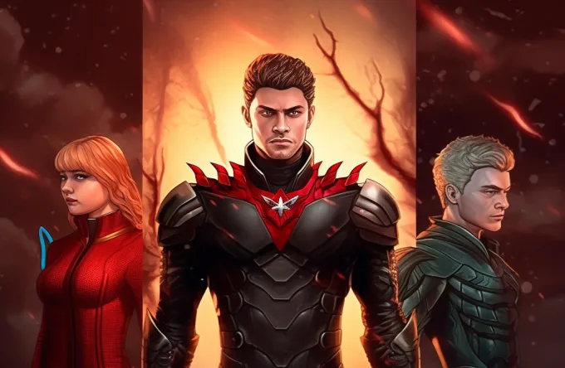

Designing Dreams in “Dashtoon”
Shivasheesh Singh
SEE ,IIT Kanpur

Slide 2
1-Introduction :
Dashtoon curates the best stories worldwide, turning them into visually striking comics and graphic novels.
Dashtoon seamlessly blends Manga creativity with American storytelling, crafting narratives that break free from traditional superhero tropes, delivering an explosion of diversity.
2-Services :
We provide technologies that assist creators in converting their ideas into stories quickly and efficiently, and ensuring consumers have access to the stories they desire
3- Position :
Dashtoon excels in B to C space within the high tech. media and entertain market segments, securing the 22nd position out of 299 competitors with a Tracxn score of 39/100
Source-racxn.com

Slide 3
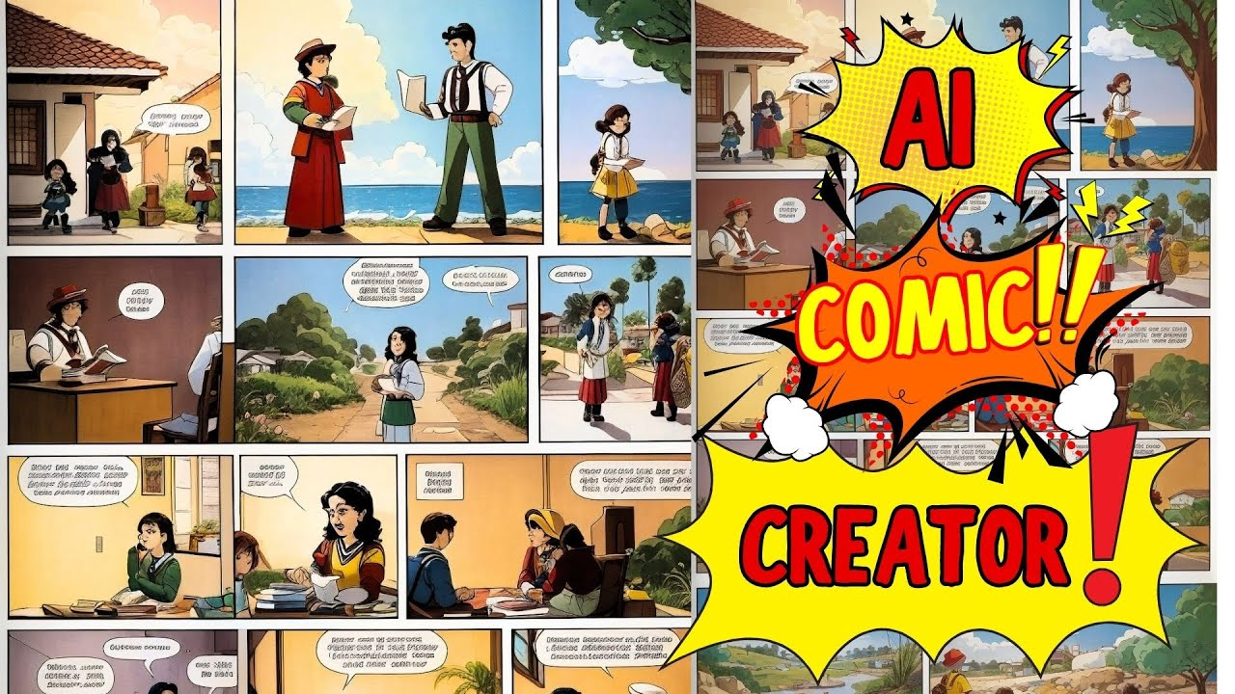
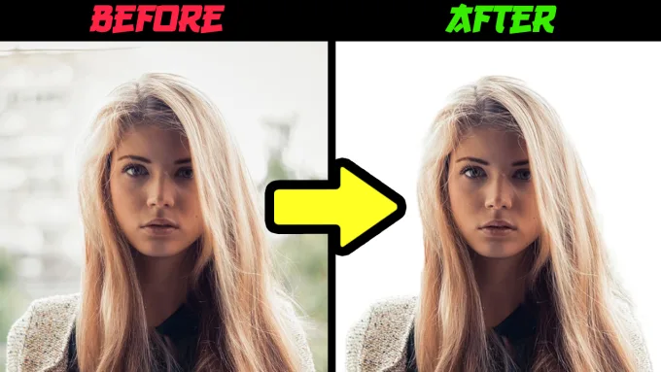
Our Features :
We do AI powered comic creation by applying certain features like background removal, image enhancement, smart color matching, and object recognition
A rich content library and daily comic releases
We offer a character library or the option to create your characters, various art styles to choose from, and AI-native tools for tasks like converting storyboards into comics
Source-racxn.com

Slide 4

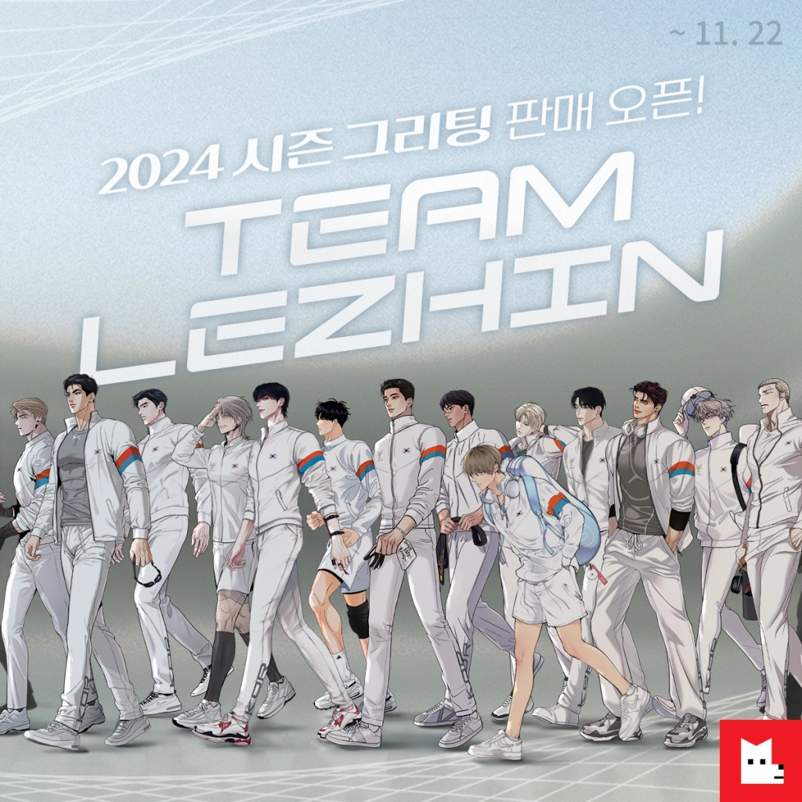
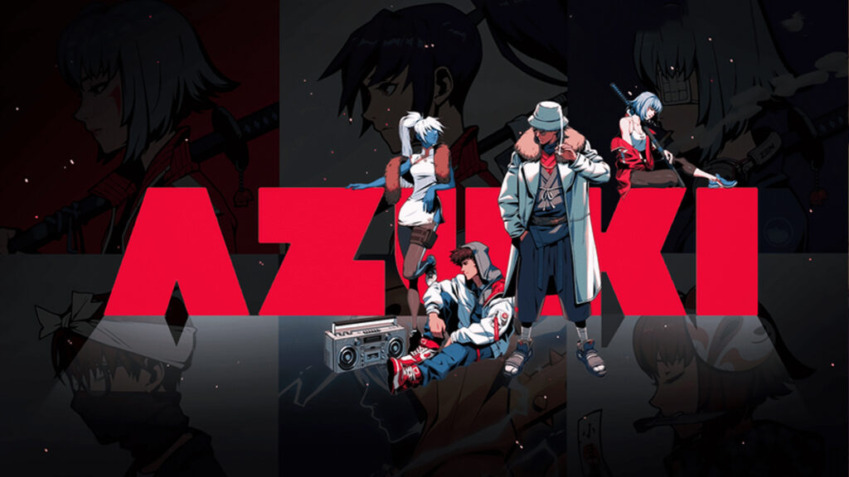
Fierce Firms / Business Battle :
Out of 299 competitors and it ranks 22nd among them
17 of its competitors are funded while 9 have exited.
There are 3 public and 6 acquired companies in the entire competition set.
Ridibooks - Seoul based, 2009 founded, Series C company
Azuki - San Francisco based, 2019 founded, Seed company
Lezhin - Seoul based, 2013 founded, Series B company
Source-racxn.com

Slide 5

Unifying Uniqueness :
The platform integrates AI technologies such as DALL-E 2, text-to-image models, Midjourney, and Stability.AI to streamline the production of high-quality comics
Aiming for a significant volume, Dashtoon plans to add almost 1,000 new episodes every month
Dashtoon operates on a freemium model, providing users with one free episode a day for each comic
Dashtoon Studio reduces the time to create an episode from 40 to 50 hours to just 5 to 6 hours, allowing for daily releases
While leveraging AI for storyboards and dialogues, Dashtoon emphasizes that human creativity is essential, with AI serving as a tool to assist in labor-intensive tasks
Source-https://openfuture.ai

Slide 6


Usability
Incredibly intuitive and accessible user interface
Customization and personalisation in user space
4.3/5 counting 284 reviews with 10k+ downloads
“I absolutely love the Dashtoon app! The stories and graphics are amazing, providing an immersive reading experience. What sets Dashtoon apart for me is the unique feature that allows me to chat with certain characters, making the stories come to life in a whole new way. It's a must-try for comic enthusiasts!“ is a random review of customer
Source-https://play.google.com

Slide 7
Business Model
AI-Powered Comic Creation
Dashtoon Studio
Content Distribution and Monetization
Freemium: One free daily episode per comic; paid subscription unlocks extra episodes and premium features
Target Audience
Dashtoon targets writers eager to transform their stories into comics, bridging the gap for those lacking drawing or lettering skills.
Revenue Generation
Revenue is driven by subscriptions, potential premium features, and diverse monetization strategies.
Content Library and Differentiation
Dashtoon differentiates with a rich content library and daily comic releases, meeting the demand for frequent updates
Long-Term Expansion
Dashtoon starts with long-form content in romance, drama, and fantasy, with plans to expand into various genres as more creators join
Investment and Growth
Dashtoon secured $5 million in seed funding led by Matrix Partners India and Stellaris Venture Partners, underscoring investor confidence in its growth in the webcomics market.
Disruption in Content Creation
Dashtoon disrupts content creation, offering an alternative to traditional labor-intensive methods in comics creation and distribution

Slide 8

Criticism and Shortcomings
Short and incomplete stories as compare to Webtoon
App requires constant coin payments, lacks free coin offers or login rewards
No way to earn points to watch more episodes
Limitation for reading is taking customers out of the ecosystem

Slide 9

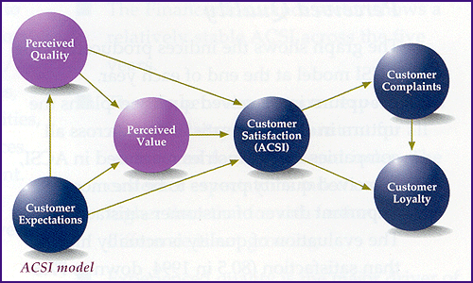
Opportunities and Overhauls
More user friendly interface
More opportunities for users to earn coins (to retain them)
Alleviate reading constraints with ecosystem-engaging features
Engage with User Feedback
Implementation of reward system
Collaborate with Established Creators

Slide 10
Summary and Scope
We have seen the service, feature, competitors, business model and review of clients up to now, however Dashtoon has a long way to go because there is no limit in comics business example is Disney and their diversifying business model.
“While good brands have legendary leaders great brand have legendary culture”
Here I am talking about retaining our already existing customer base by introducing different pricing model (refer the pricing model of Gillette, Sony playstation or beginning of Jio) and delivering them exceptional user experience (Customer journey approach of purchase and use)

Slide 11
A new approach can be…
Adding a new kink into customer experience is the best way to establish yourself as remarkable because “when the process becomes normal then breaking the expectations creates an innovative enjoyment from new content”, an idea for the same may be…
Iteration Upcycle Framework
Prioritize key element identification from past work
Crucial analysis justifying its significance
Improve Them
Apply them in different areas

